Slide 1
Newborn Baby
http://www.youtube.com/watch?v=hdCbuF8_1p8
http://www.youtube.com/watch?v=laxyoaHOP1c (twins)

Slide 2
Learning Goals:
Define infant mortality and the infant mortality index.
What are the purpose of reflexes?
What are states of infant arousal?
Characterize infant sleep.
Characterize infant crying.
What is SIDS?

Slide 3
Infant Mortality
Infant Mortality- the number of deaths in the first year of life per 1,000 live births
Infant Mortality Index- index used around the world to assess the overall health of a nation’s children
U.S. Infant Mortality Rate- 5.9 infant deaths per 1,000 births (2017)
  Despite our advanced health-care technology, we rank poorly compared to European countries; 7th in 1950 to 26th in 2010
  America’s ethnic poor are at greatest risk for infant death
  (poor infants are 2x as likely to die in the first year of life)
  US by State: https://www.statista.com/statistics/252064/us-infant-mortality-rate-by-ethnicity-2011/

Slide 4
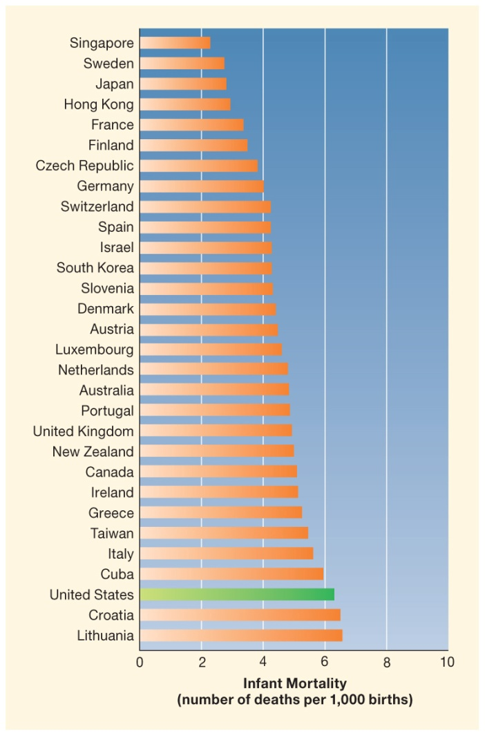

Slide 5
Neonatal Mortality
Neonatal mortality- rate of death within the first month of life
  Accounts for 67% of U.S. infant death rate
Serious Physical Defects- cannot be prevented & occurs proportionately across ethnicities and SES
Low-Birth Weight- largely preventable & more likely to occur to ethnic-minority families living in poverty
What Gives?
  Widespread poverty and weak health-care programs for mothers and young children are responsible for these trends
  Each country that out ranks us provides its citizens with government-sponsored health-care benefits
    Mothers have access to nutrition, high-quality medical care, social & emotional support that promote parenting

Slide 6
Newborn Reflexes
Reflex- inborn, automatic response to a particular form of stimulation
  Form the basis of complex behavior
  Help parent-child interact and bond
Examples
  Moro Reflex- arch back, extend arms outward, then inward
  Rooting Reflex- helps baby find nipple (pacifier)
  Palmer Grasp Reflex- encourages parents to respond lovingly
Most reflexes disappear during first six months due to gradual increase in control over behavior (as cortex develops)

Slide 7
Newborn States
State of arousal- degrees of sleep and wakefulness
State | Description | Duration
Regular Sleep | Full rest, little activity | 8-9 hours
Irregular Sleep | Gentle limb movements Stirring, facial grimacing | 8-9 hours
Drowsiness | Falling asleep Waking up | Varies
Quiet Alertness | Body inactive Open eyes, attentive | 2-3 hours
Waking Activity Crying | Bursts of uncoordinated body activity, crying | 1-4 hours

Slide 8
Sleep
Regular Sleep- NREM
  Body is motionless
  Heart rate, breathing, brain wave activity slow & even
Irregular Sleep- REM
  Brainwave activity is similar to awake state
  Eye darting
  Slight body movement
  Heart rate, breathing, blood pressure uneven
  Most REM sleep of the lifespan

Slide 9
Crying
Crying is the first way babies communicate
  Food, comfort, stimulation
  Ranges from whimper to full-out distress
  Parents learn the different crying behavior
Why?
  Young infants mostly cry because of physical needs:
    Mostly hunger
    Temperature change
    Sudden noise
    Another baby crying
    (peaks at 6 weeks)

Slide 10
Crying
How to sooth crying?
When feeding & diaper changing doesn’t work:
  Lifting baby to shoulder, rocking, walking, driving
  Swaddling
Abnormal Crying
Crying is a clue to central nervous system
Babies with prenatal or birth complication have shrill-piercing-short cry
Colic- persistent crying, strong reactions to stimuli
  The cause is unknown
  Subsides between 3-6 months

Slide 11
Crying
Parental Response
Most respond with extra care and attention
Can be source of frustration
Ill babies are more likely to be abused by highly stressed parents

Slide 12
SIDS: Sudden Infant Death Syndrome
SIDS- unexpected and unexplained death, usually during the night, of an infant under age 1
Leading cause of death of infant mortality
Precise cause is unknown but is related to problems from the beginning:
  Prematurity, low-birth weight, low apgar scores, limp muscle tone
  Abnormal heart rate, respiration, and disturbances of sleep
  At time of death infants usually have a mild respiratory infection
Hypothesis: impaired brain functioning these infants from learning how to respond when their survival is threatened

Slide 13
http://www.youtube.com/watch?v=m9QndNXcnCU (24 hours with a newborn

Slide 14
Physical Development
Infancy & Toddlerhood

Slide 15
Learning Goals:
Depict body growth during infancy-toddlerhood
Depict brain development
  Neurons, cortex, synaptic pruning
What are sensitive periods?
What is proper infant-toddler stimulation?

Slide 16
Body Growth
Body Size
  By 5 months weight doubles
  By year 1 weight has tripled
  By year 2 weight has quadrupled
Early rise in body fat (babies get plump) to regulate temperature
  Peaks at 9 months
By toddlerhood slim down

Slide 17
Body Growth
Body Proportions: two growth patterns
  Cephalocaudal trend: “head to tail”
    Head develops more rapidly
  Proximodistal trend: “near to far”
    Develops from center of body outward
Gender Differences
  Girls are slightly shorter and lighter
  Cross cultural differences
  Skeletal age is best estimate of age

Slide 18
Brain Development
Development of neurons
Development of cerebral cortex

Slide 19
Neurons
Neurons- nerve cells comprise of human brain (100-200 billion)
Synapses- tiny gaps where fibers from different neurons come close together
Neurotransmitters- neurons send messages to one another through these chemicals
  Synaptic pruning- neurons that are not stimulated are lost
  Myelination- coating of neural fibers that improves efficiency

Slide 20
Cerebral Cortex
Cerebral cortex- surrounds brain resembling half of a shelled walnut
  Largest most complex brain structure
  Accounts for 85% of brain’s weight containing largest number of neurons and synapses
  Last brains structure to stop growing
  Very sensitive to environmental influences

Slide 21
Cerebral Cortex
Four Regions (lobes):
  Frontal, temporal, occipital, parietal
Two hemispheres:
  Right: spatial abilities (judging distances, reading maps, recognizing shapes)
  Left: verbal abilities (spoken, written language, math)
Plasticity: highly plastic cortex has a high capacity for change and learning

Slide 22
Sensitive Periods in Brain Development
Extreme sensory deprivation results in permanent brain damage and loss of function
  Early varied visual experiences must occur for brain’s visual centers to develop normally
Kitten’s vision
Animals reared from birth in physically and socially stimulating environments vs. isolation

Slide 23
Sensitive Periods in Brain Development
Romanian Orphans
  Birth and 3 ½ years transferred environments
  Longer in deprivation, more negative outcomes
  “Catch-up” occurred
  Early chronic stress disrupts neuroendocrine regulation
    Very high levels of cortisol
    Very low levels of cortisol

Slide 24
Appropriate Stimulation for
Brain Development
Too Little -----------Vs.----------Too Much
How can we distinguish the two?
Experience-expectant brain growth: depends on ordinary experiences- opportunities to touch, see, hear language and explore environment
Experience-dependent brain growth: consists of additional growth and refinement of established brain structures as a result of specific learning (varies greatly across individuals)

Slide 25
http://www.youtube.com/watch?v=_0EYXx9iI64&feature=related

